Slide 1
Rating Prediction
Submitted by – Amruta Shah

Slide 2
Information
We have a client who has a website where people write different reviews for technical products. Now they are adding a new feature to their website i.e. The reviewer will have to add stars(rating) as well with the review. The rating is out 5 stars and it only has 5 options available 1 star, 2 stars, 3 stars, 4 stars, 5 stars. Now they want to predict ratings for the reviews which were written in the past and they don’t have a rating. So, we have to build an application which can predict the rating by seeing the review.
This project can very useful for all eCommerce customers to grow their online business and also to improve their product quality as well as other performance by pre prediction.
The ability to successfully decide whether a review will be helpful to other customers and thus give the product more exposure is vital to companies that support these reviews, companies like Flipkart, Amazon etc.

Slide 3
Problem Statement: -
There are two main methods to approach this problem. Frist one is Data Collection that is you have to scrape the reviews of different laptops, Phones, Headphones, smart watches, Professional Cameras, Printers, Monitors, Home theatre, Router from different eCommerce websites. Basically, we need these columns 1) reviews of the product and 2) rating of the product. And convert all the ratings to their round number, as there are only 5 options for rating i.e., 1,2,3,4,5. If a rating is 4.5 convert it 5.
Second one is Model Building phase that means after collecting the data, we need to build a machine learning model. Before model building we have to do all data pre-processing steps. With different models with different hyper parameters and select the best model. By following the complete life cycle of data science. Include all the steps like
1. Data Cleaning
2. Exploratory Data Analysis
3. Data Pre-processing
4. Model Building
5. Model Evaluation
6. Selecting the best mode

Slide 4
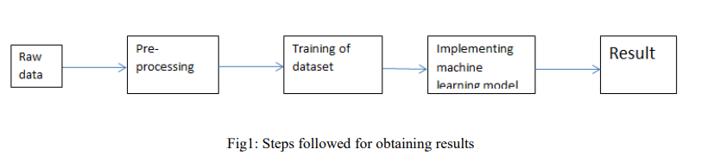
Methodology:-
The steps followed in this work, right from the dataset preparation to obtaining results are represented in Fig.

Slide 5
EDA (Exploratory Data Analysis):-
Import libraries: -
Import pandas as pd # for data manipulation
Import numpy as np # for mathematical calculations
Import seaborn as sns # for data visualization
Import matplotlib.pyplot as plt #for graphical analysis
%matplotlib inline
Import warnings # to ignore any warnings

Slide 6
Technical Requirements:
Mathematical Summary:
Dimensions of Dataset: There are 3 columns and 22048 rows in this dataset.
Null Values: There are null values in this dataset.
Skewness: Skewness is present in column.
Statistical Summary: Standard deviation is very high in most of the columns.
Special Character are present in both dataset (train and test).
Data Sources and their formats:
Data Sources: I have scrapped the train & test data from the different data sources like Amazon, Flipkart etc. In order to improve the ecommerce services , the client wants some predictions that could help them in further investment and improvement in services of ecommerce sites . This project is multiclass classification type as it has 5 type of class which we have to predict like Rating 1,2,3,4,5 that indicates Best, Good, Average, worst & very worst rating.
Data Formats: Text & Review columns are object datatype which we need to encode & pre-process.

Slide 7
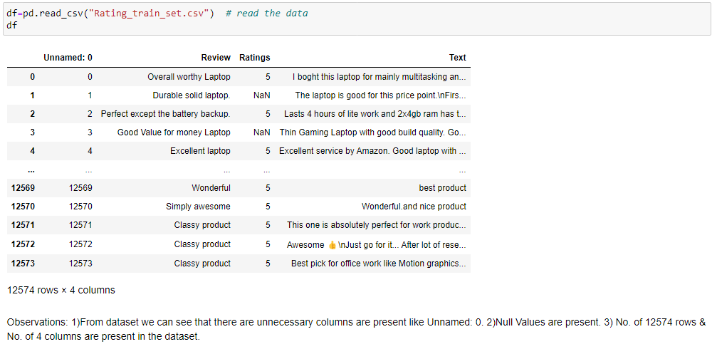
Load Dataset

Slide 8
Observations
Dimensions of Dataset: There are 3 columns and 22048 rows in this dataset(both tarin and test).
Null Values: There are null values in this dataset.
Skewness: Skewness is present in every column Statistical.
There is data imbalance in target variable.

Slide 9
Data Visualization
We now have a basic idea about the data. We need to extend that with some visualizations. We are going to look at three types of plots:
Univariate plots to better understand each variable.
Bivariate plots to find relationship between two variables,
Multivariate plots to better understand the relationships between variables.

Slide 10
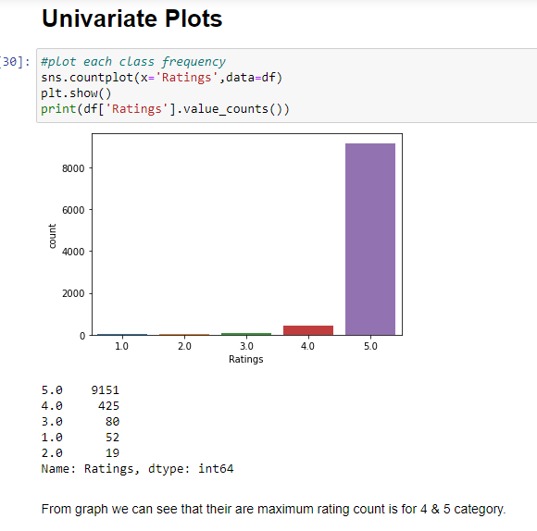
Univariate Plots:-

Slide 11
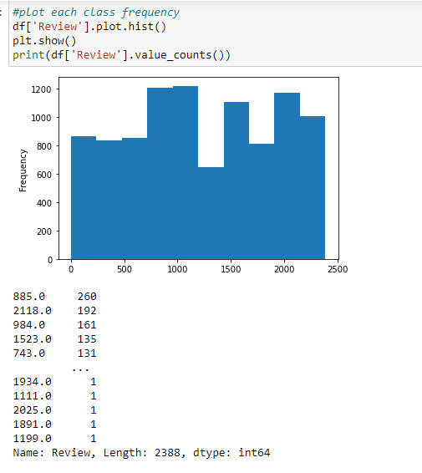
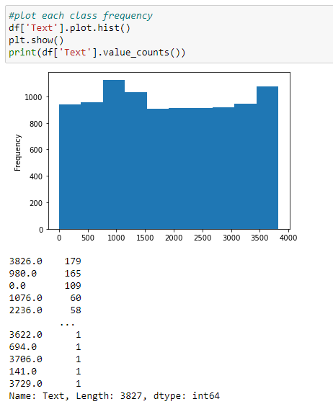

Slide 12
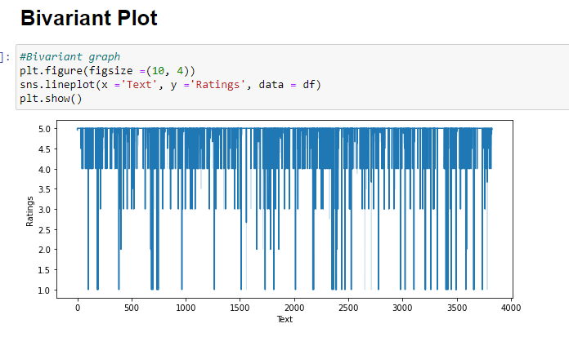
Bivariate Plot

Slide 13
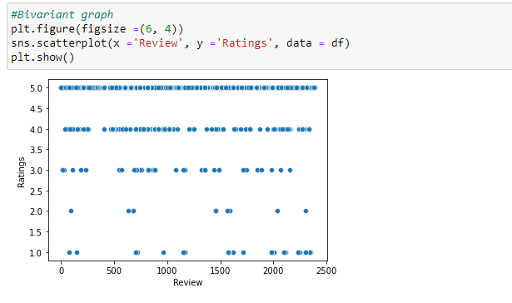

Slide 14
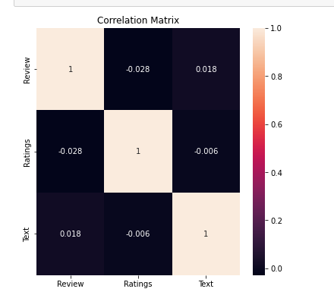
Multivariate Plot

Slide 15
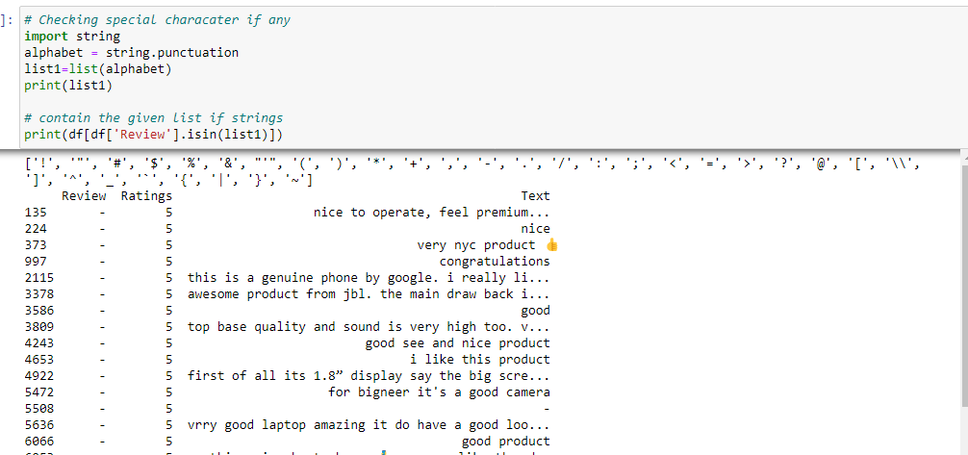
Data Pre-processing:-
First of all, I have dropped irrelevant columns 'unknown:0'.
Then check for the duplicates some duplicates are found which is delated. After dropping the duplicated the shape of dataset is (rows=18174, columns=3) from both train and test dataset.
Moving further as we have special characters in columns so I have removed from both the columns as shown below

Slide 16
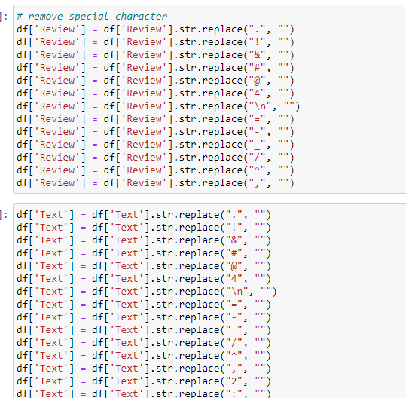
Data Pre-processing:-

Slide 17
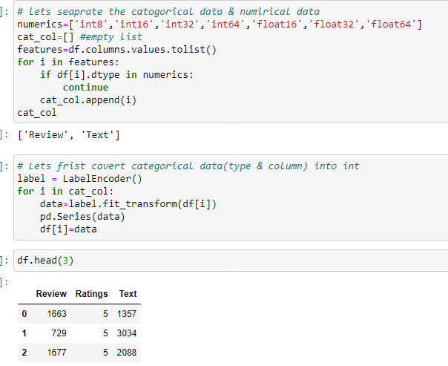
Data Pre-processing:-
As our dataset has objective type data so covert them into int by using Encoding method as shown.

Slide 18
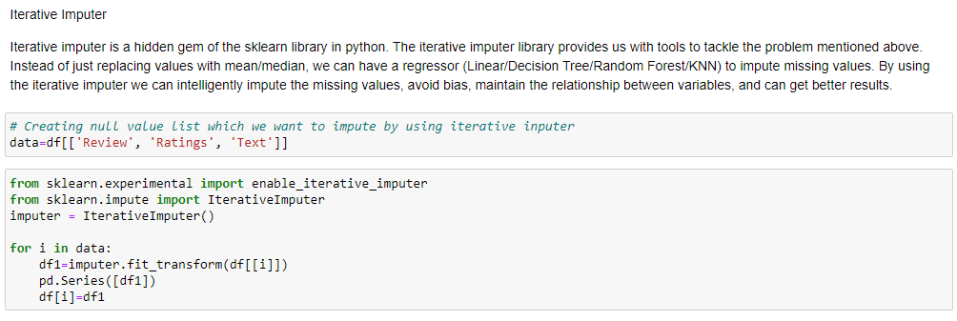
Data Pre-processing:-
Also, there are some Null values are present in the all columns so I have used mode method and iterative imputer to deal with it as shown in below fig.

Slide 19
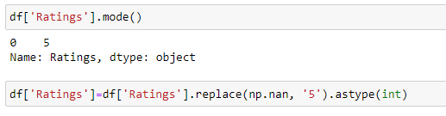
Data Pre-processing:-
Also, there are some Null values are present in the all columns so I have used mode method and iterative imputer to deal with it as shown in below fig.

Slide 20
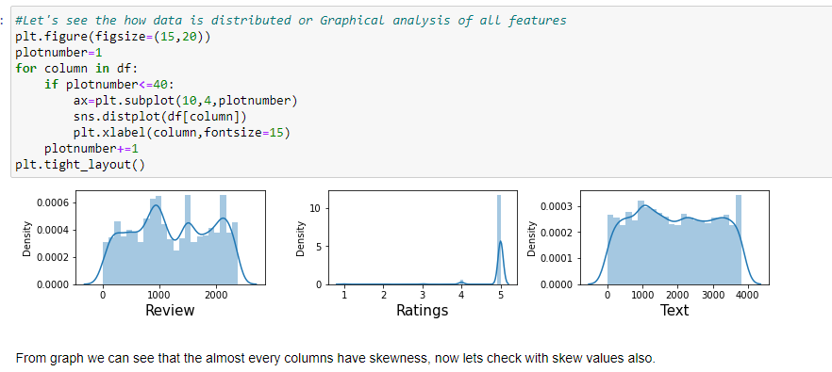
Check Skewness

Slide 21

Power Transformation to remove skewness

Slide 22
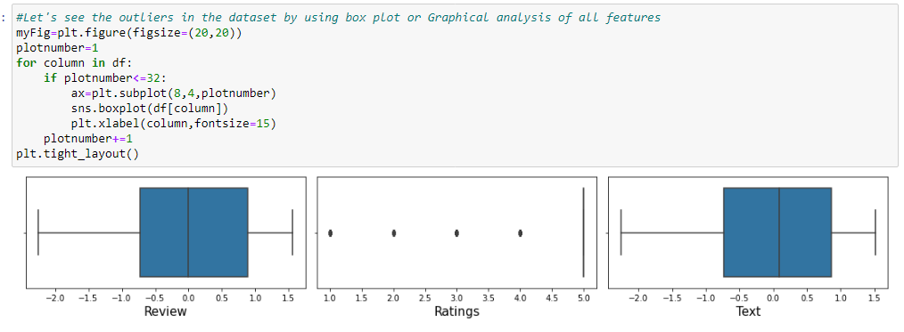
Distribution to see outliers

Slide 23
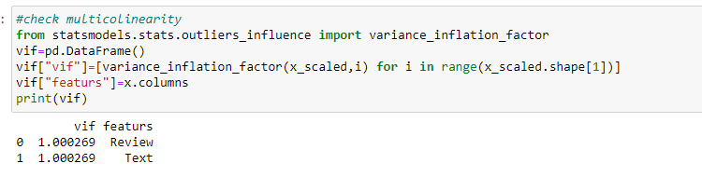
Multicollinearity by VIF

Slide 24
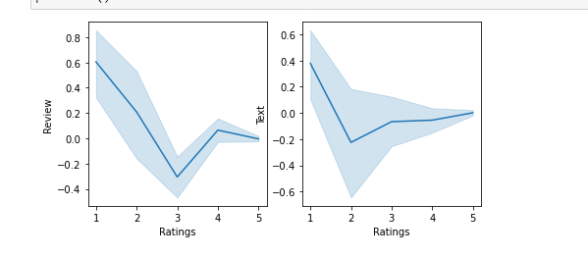
Data Inputs- Logic- Output Relationships

Slide 25
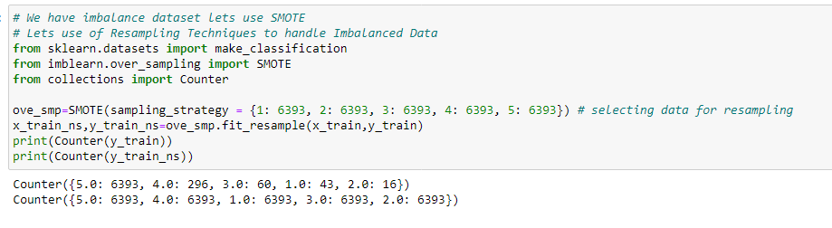
Data Imbalance Handling:

Slide 26
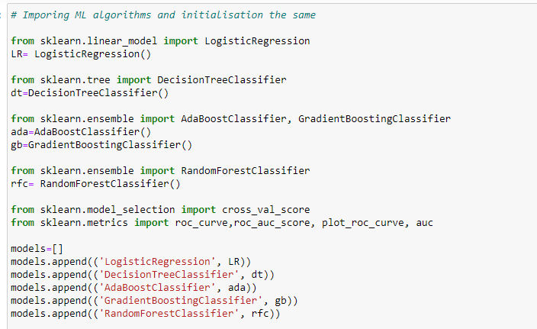
Build the models & select best one

Slide 27
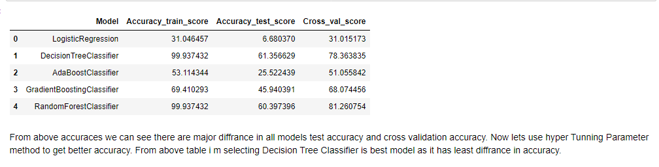
All models accuracy

Slide 28
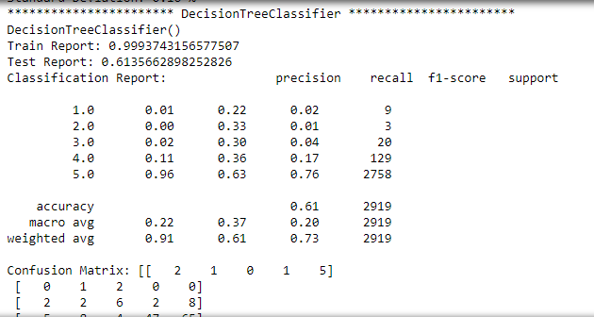
Selected Model

Slide 29
In this project we build the multiclassification model that can predict rating based on reviews. The challenge behind predicting models is EDA & data scrapping. We have gone through how to implement the entire machine learning pipeline, and we have an intuitive understanding of machine learning algorithms. The larger the dataset gets, the more complex each of the mentioned steps gets. Therefore, using this as a base will help while you build your knowledge of machine learning pipelines. This Paper has presented a supervised rating prediction learning model which used machine learning algorithms to predict the rating. We used different machine learning algorithm to check the accuracy of rating prediction.
Conclusion and Future Scope: -

